Slide 1

POSCAT Seminar 8 :
Dynamic Programming 2
yougatup @ POSCAT

Slide 2
Topic
Topic today
  Dynamic Programming
    Longest Palindrome
    Team Division

Slide 3
Longest Palindrome
Problem
  A palindrome is a word that reads the same forward or reversed
  Given string, find the length of longest palindrome among the subsequence.
  b a b a c v a b b a

Slide 4
Longest Palindrome
Problem
  A palindrome is a word that reads the same forward or reversed
  Given string, find the length of longest palindrome among the subsequence.
  b a b a c v a b b a

Slide 5
Longest Palindrome
Problem
  A palindrome is a word that reads the same forward or reversed
  Given string, find the length of longest palindrome among the subsequence.
  b a b a c v a b b a
  1. Define the Table

Slide 6
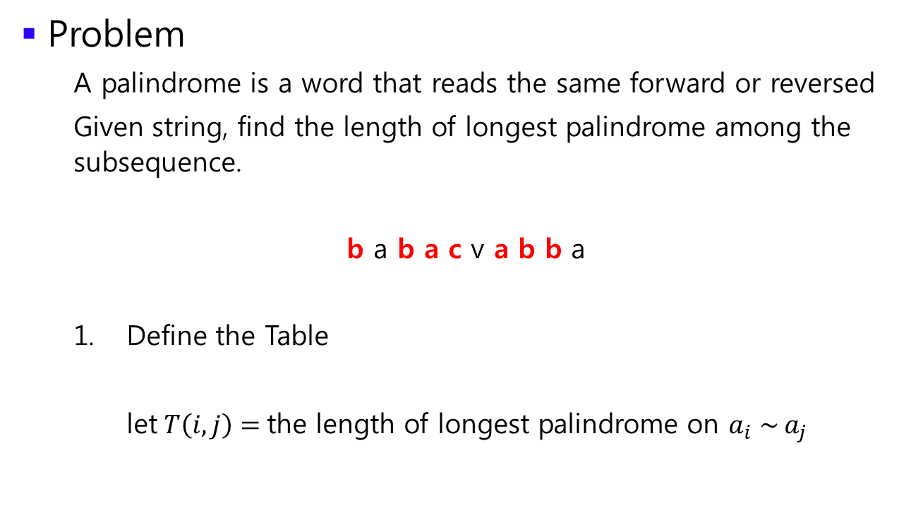
Longest Palindrome
Problem
  A palindrome is a word that reads the same forward or reversed
  Given string, find the length of longest palindrome among the subsequence.
  b a b a c v a b b a
  Define the Table
  let$T\left(i, j\right)=$the length of longest palindrome on $a_{i} \sim a_{j}$

Slide 7
Longest Palindrome
Problem
  A palindrome is a word that reads the same forward or reversed
  Given string, find the length of longest palindrome among the subsequence.
  b a b a c v a b b a
  2. Find a recurrence relation

Slide 8
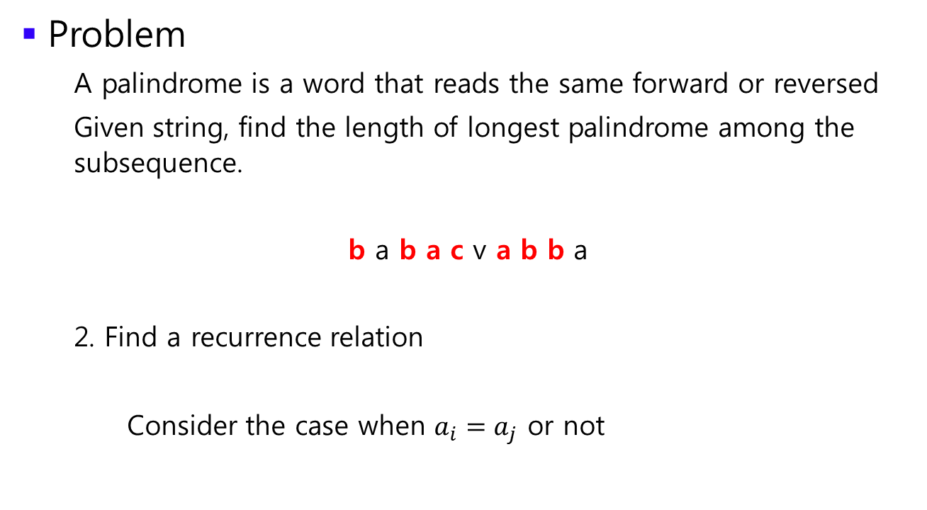
Longest Palindrome
Problem
  A palindrome is a word that reads the same forward or reversed
  Given string, find the length of longest palindrome among the subsequence.
  b a b a c v a b b a
  2. Find a recurrence relation
  Consider the case when $a_{i}=a_{j}$ or not

Slide 9
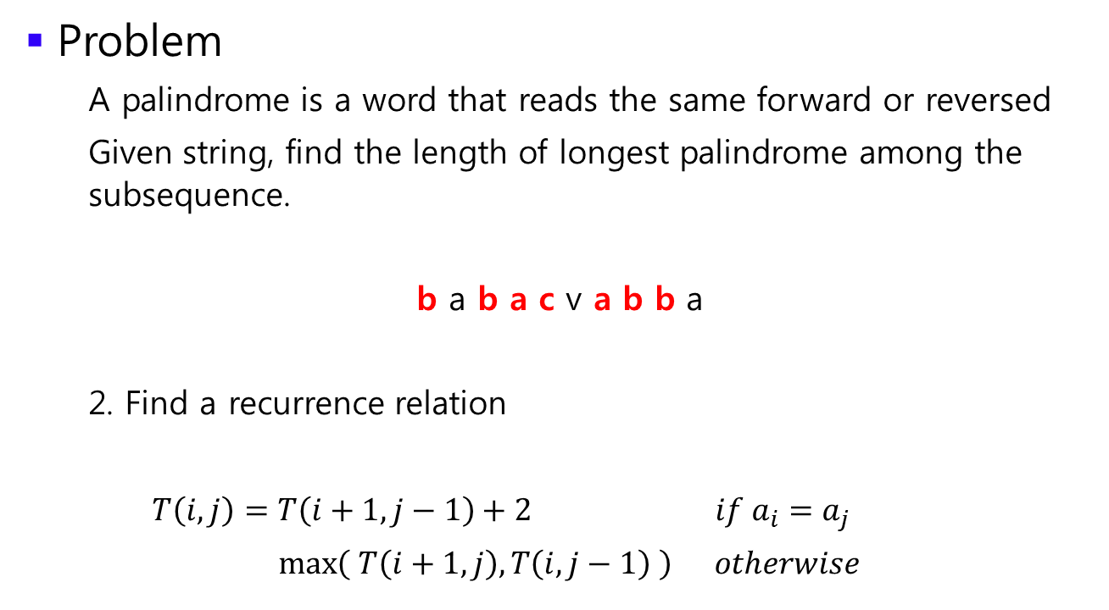
Longest Palindrome
Problem
  A palindrome is a word that reads the same forward or reversed
  Given string, find the length of longest palindrome among the subsequence.
  b a b a c v a b b a
  2. Find a recurrence relation
  $T\left(i, j\right)=T\left(i+1, j−1\right)+2 if a_{i}=a_{j}$
  $\max\left( T\left(i+1, j\right), T\left(i, j−1\right) \right) otherwise$

Slide 10
Longest Palindrome
Problem
  A palindrome is a word that reads the same forward or reversed
  Given string, find the length of longest palindrome among the subsequence.
  b a b a c v a b b a
  3. Calculate !
  Think carefully about the filling direction

Slide 11

Team Division
Problem
  Suppose that we can divide $n$ numbers into $m$ chunks.
  Minimize the maximum value of sum of each chunk.
  For example, let $m=3$
  1 2 5 3 4 2 6 7 3 4

Slide 12

Team Division
Problem
  Suppose that we can divide $n$ numbers into $m$ chunks.
  Minimize the maximum value of sum of each chunk.
  For example, let $m=3$
  1 2 / 5 3 4 2 6 / 7 3 4

Slide 13

Team Division
Problem
  Suppose that we can divide $n$ numbers into $m$ chunks.
  Minimize the maximum value of sum of each chunk.
  For example, let $m=3$
  1 2 / 5 3 4 2 6 / 7 3 4
  3 20 14

Slide 14

Team Division
Problem
  Suppose that we can divide $n$ numbers into $m$ chunks.
  Minimize the maximum value of sum of each chunk.
  For example, let $m=3$
  1 2 / 5 3 4 2 6 / 7 3 4
  3 20 14
  $∴$ we get 20

Slide 15

Team Division
Problem
  Suppose that we can divide $n$ numbers into $m$ chunks.
  Minimize the maximum value of sum of each chunk.
  For example, let $m=3$
  1 2 5 3 / 4 2 6 / 7 3 4

Slide 16

Team Division
Problem
  Suppose that we can divide $n$ numbers into $m$ chunks.
  Minimize the maximum value of sum of each chunk.
  For example, let $m=3$
  1 2 5 3 / 4 2 6 / 7 3 4
  11 12 14

Slide 17
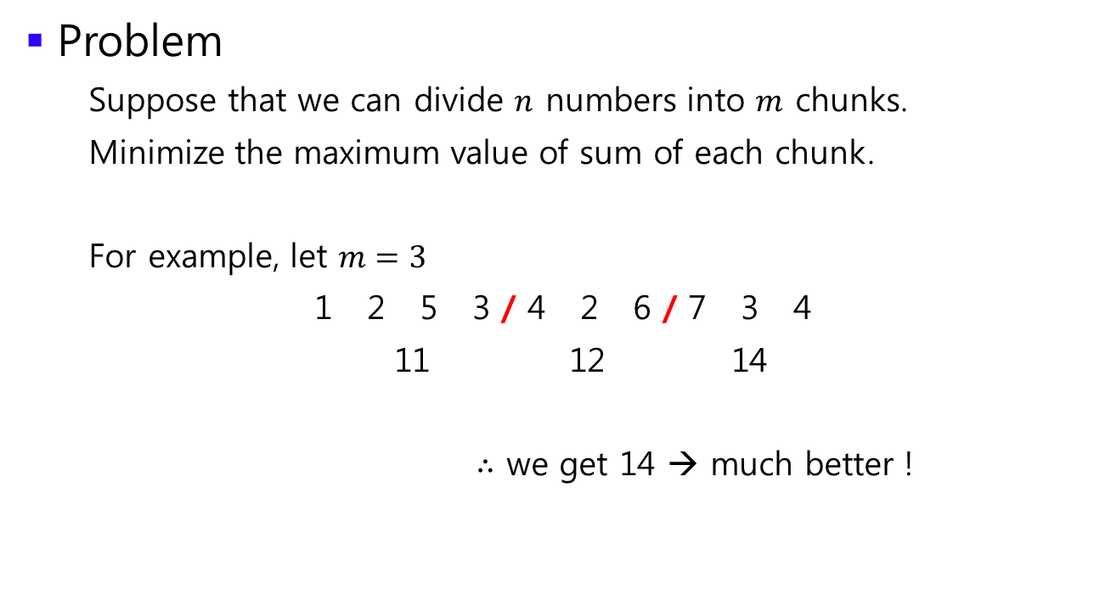
Team Division
Problem
  Suppose that we can divide $n$ numbers into $m$ chunks.
  Minimize the maximum value of sum of each chunk.
  For example, let $m=3$
  1 2 5 3 / 4 2 6 / 7 3 4
  11 12 14
  $∴$ we get 14 → much better !

Slide 18

Team Division
Problem
  Suppose that we can divide $n$ numbers into $m$ chunks.
  Minimize the maximum value of sum of each chunk.
  Define the Table

Slide 19
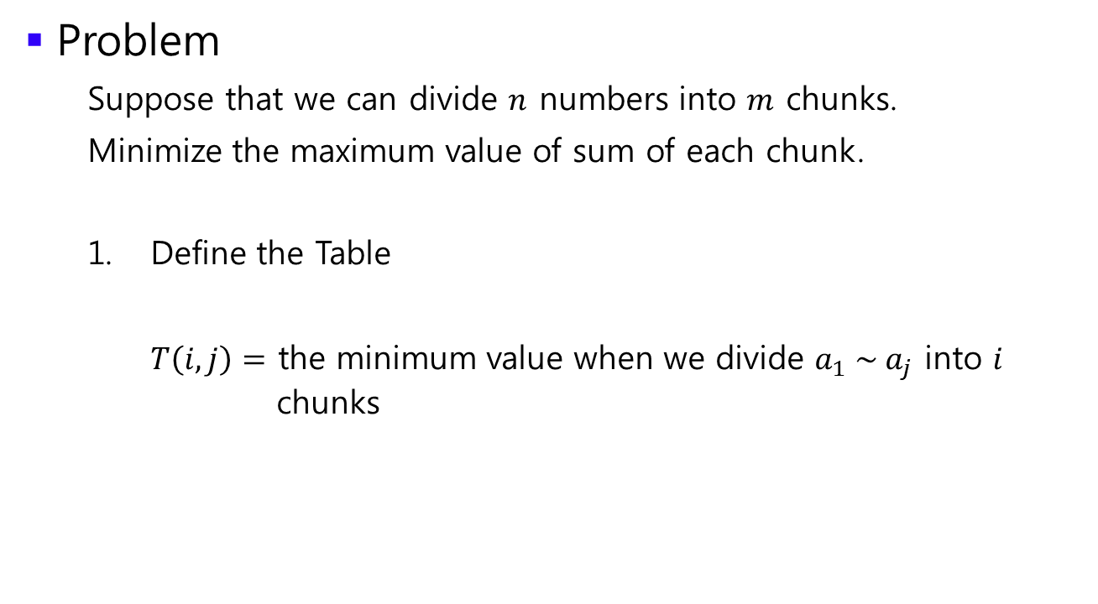
Team Division
Problem
  Suppose that we can divide $n$ numbers into $m$ chunks.
  Minimize the maximum value of sum of each chunk.
  Define the Table
  $T\left(i, j\right)=$ the minimum value when we divide $a_{1} \sim a_{j}$ into $i$ chunks

Slide 20

Team Division
Problem
  Suppose that we can divide $n$ numbers into $m$ chunks.
  Minimize the maximum value of sum of each chunk.
  Find a recurrence relation

Slide 21
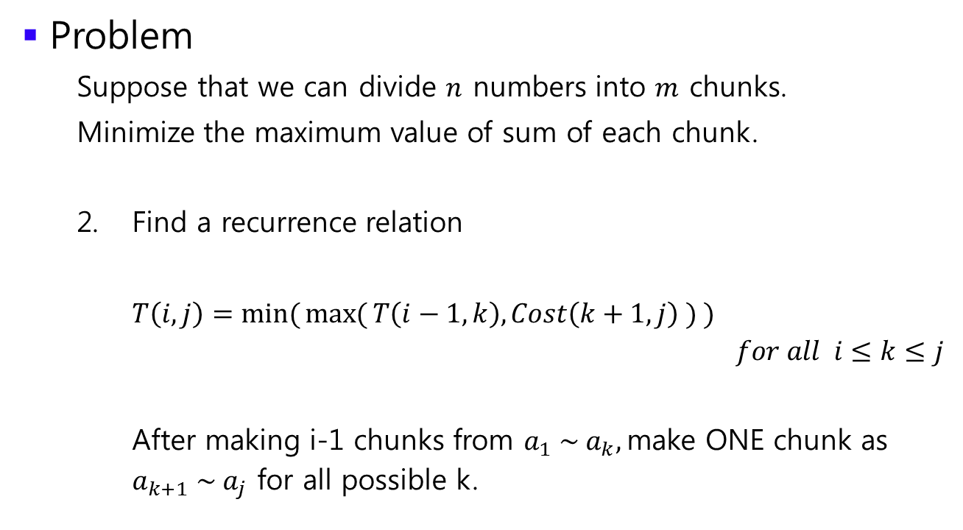
Team Division
Problem
  Suppose that we can divide $n$ numbers into $m$ chunks.
  Minimize the maximum value of sum of each chunk.
  Find a recurrence relation
  $T\left(i, j\right)=\min{(}\max{(}T\left(i−1, k\right),Cost\left(k+1, j\right) ) )$
  $for all i≤k≤j$
  After making i-1 chunks from $a_{1} \sim a_{k},$make ONE chunk as
  $a_{k+1} \sim a_{j}$ for all possible k.

Slide 22

Team Division
Problem
  Suppose that we can divide $n$ numbers into $m$ chunks.
  Minimize the maximum value of sum of each chunk.
  Calculate !

